Slide 1

Stack Overflow Developer Survey
Josh Eversman

Slide 2



OUTLINE
Executive Summary
Introduction
Methodology
Results
Visualization – Charts
Dashboard
Discussion
Findings & Implications
Conclusion
Appendix

Slide 3

EXECUTIVE SUMMARY
Introduction
Methodology
Findings
Trends
Dashboard
Overall Findings & Implications
Conclusion

Slide 4

INTRODUCTION
Stack Overflow Developer Survey
50,000+ responses across many demographics, backgrounds, experience levels, etc.
Comprehensive survey provides for an in depth and accurate look into current and future trends

Slide 5

METHODOLOGY
Data Collection
APIs
Webscraping
Data Wrangling
Find & Remove Duplicates
Normalize Data
Exploratory Data Analysis
Analyze Distribution
Find Correlation
Data Visualization
Building A Dashboard

Slide 6
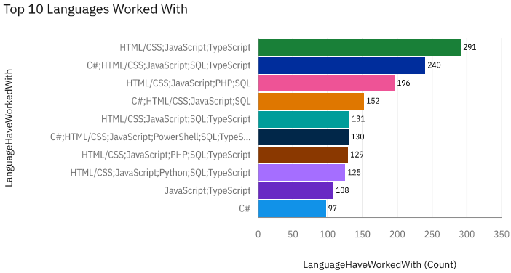
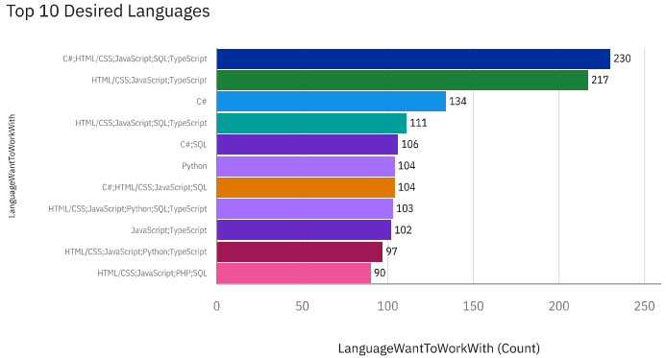
PROGRAMMING LANGUAGE TRENDS
Current Year
Next Year

Slide 7
PROGRAMMING LANGUAGE TRENDS - FINDINGS & IMPLICATIONS
Findings
HTML/CSS, JavaScript & TypeScript are both widely used in the present yet heavily sought after for future use
C# & Python is a desired language to work with
Implications
HTML/CSS, JavaScript & TypeScript business investment should continue into the future to attract top talent
Increase C# & Python investment and training

Slide 8
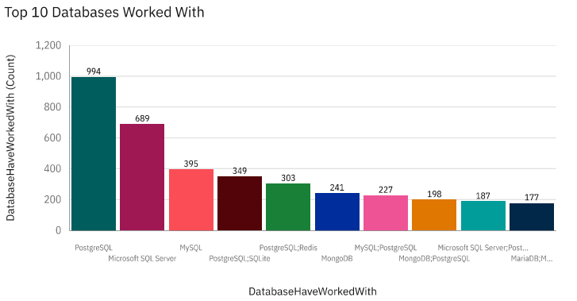
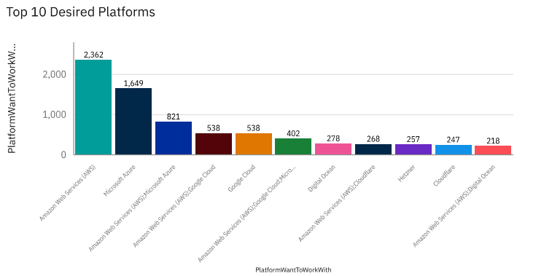
DATABASE TRENDS
Current Year
Next Year

Slide 9
DATABASE TRENDS - FINDINGS & IMPLICATIONS
Findings
AWS is very heavily sought after by developers
PostgreSQL is well known yet not typically desired
Microsoft Azure popularity growing quickly
Implications
Increase investment and training in AWS
Likely due to lack of user friendliness and/or outdated platform
Cloud computing is growing quickly

Slide 10

DASHBOARD
https://github.com/JBGopher25/IBM-Data-Analyst-Capstone

Slide 11
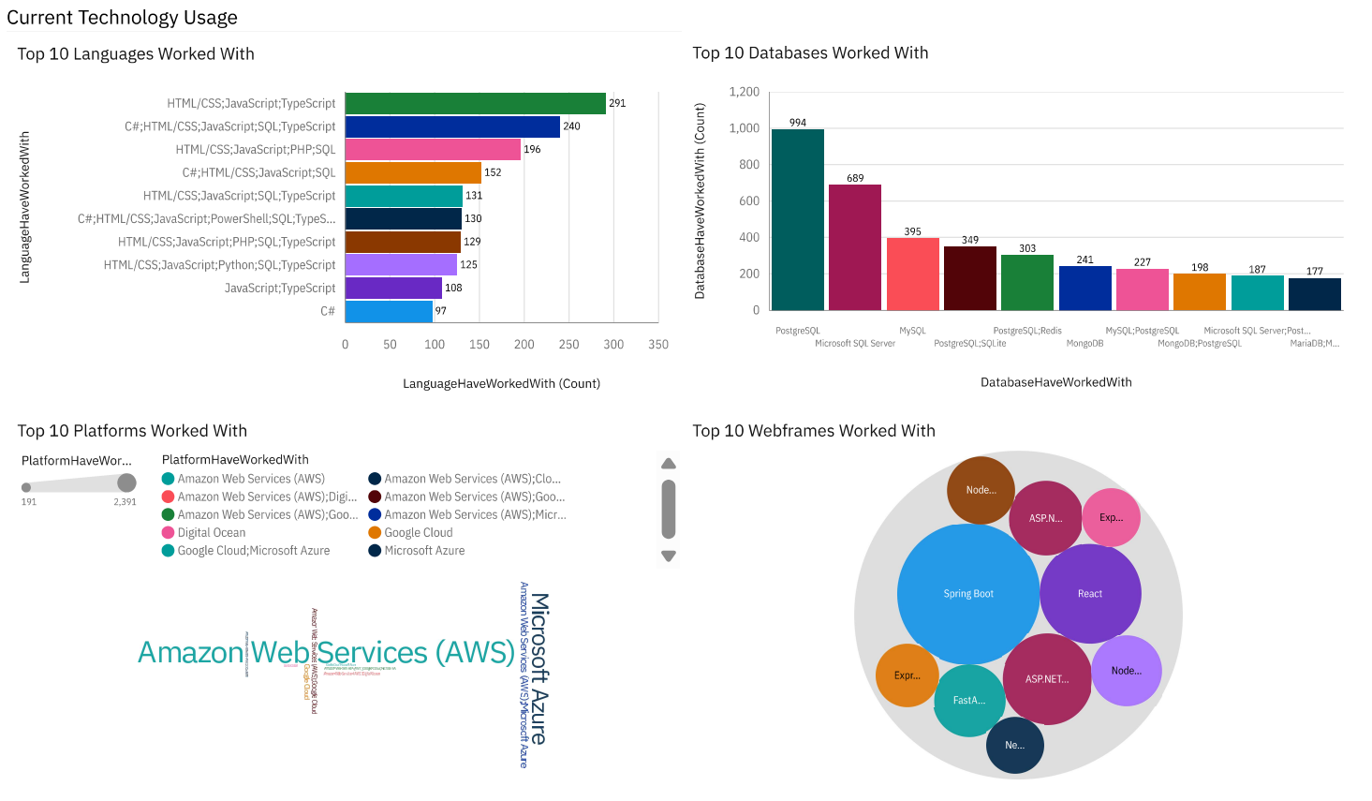
DASHBOARD TAB 1

Slide 12
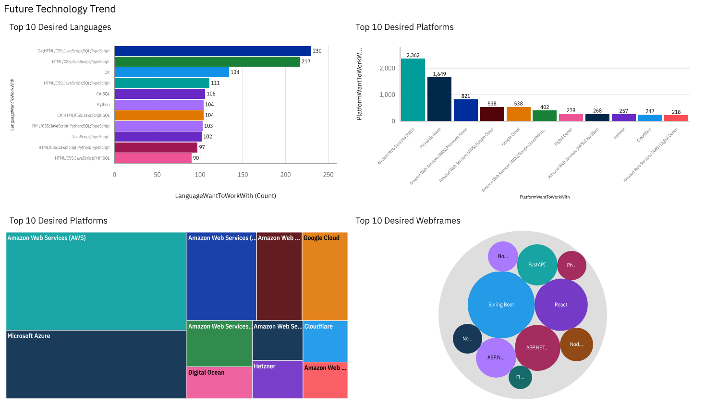
DASHBOARD TAB 2

Slide 13
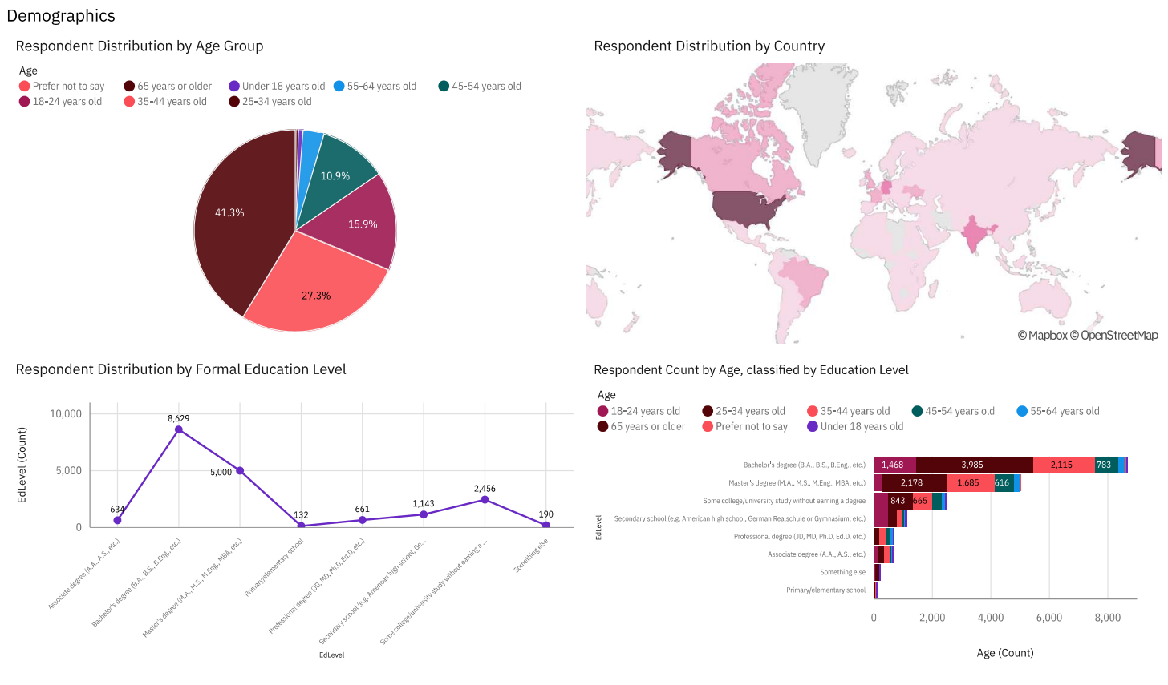
DASHBOARD TAB 3

Slide 14
DISCUSSION

Slide 15
OVERALL FINDINGS & IMPLICATIONS
Findings
Developers tend to enter workforce with Bachelor’s Degree
Majority of developers located in US
Most platforms that are understood and widely worked with, are also heavily desired
Implications
Requiring higher education on job postings could be greatly hurting ability to find talent
Consolidate developer operations to US to reduce costs without drastically hurting talent pool
Continue to do more of the same with platform investment

Slide 16

CONCLUSION
Developers mostly fall within the Gen Z and Millennial generations
Developers understand a wide variety of platforms, databases, languages, etc.
Developer talent pool mostly contained to develop countries, especially USA
Post-Grad endeavors not common amongst developers

Slide 17
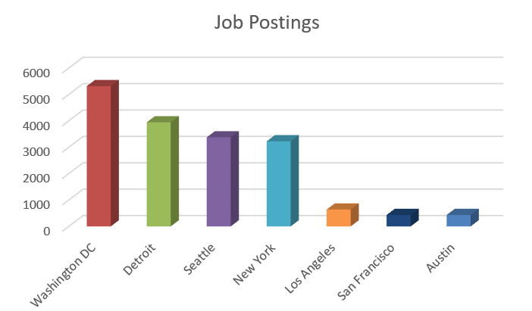
JOB POSTINGS

Slide 18
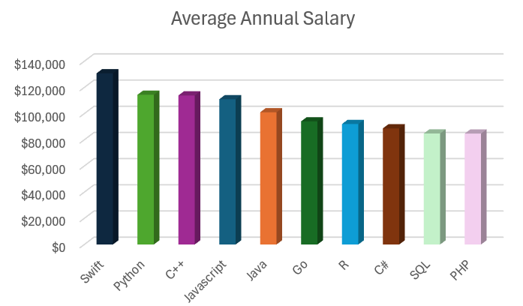
POPULAR LANGUAGES

